Slide 1
Diffusion-based Image Inpainting
Caleb Simpson

Slide 2
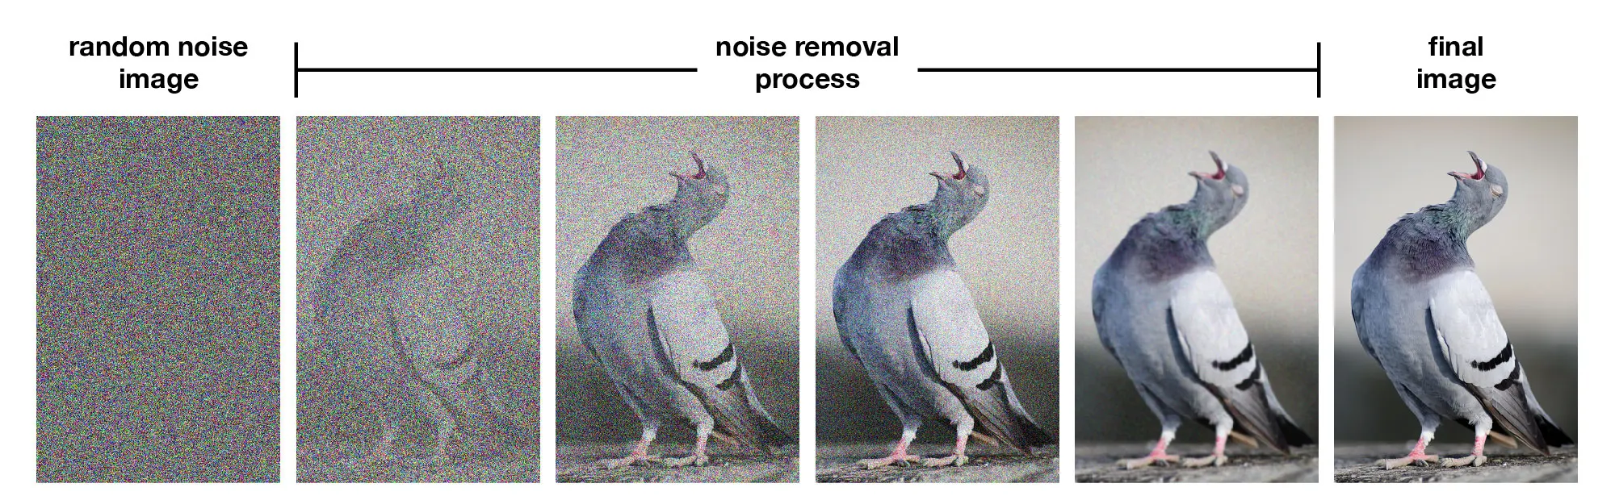
What is Diffusion-Based AI Model
It’s a generative model that starts off with a noisy image and uses machine learning to clean it up over many runs, until you get a high-quality image.

Slide 3

What is Image Inpainting
Fill missing or masked regions of images
Generate realistic content matching surroundings
Applications: Photo restoration, object removal.
A great example is Adobe Photoshop’s generative fill tool

Slide 4


What is a U-Net
The U-Net is the brain of the system. It is a part of the AI that looks at a noisy image
and tries to clean it up.
Encoder – Breaks the Image down into more manageable chunks
Decoder – Starts from chunks, and rebuilds the image
Notes:
U-Net looks at the big picture, then reconstructs details.
Helps the AI understand structure and fill in missing areas.
Downsamples – Makes it smaller
Encoder starts with broad features, like the colors, and textures, then Deeper layers like objects or structures.
Encoder (Going Down):
"I understand this is a face/pattern" (high-level)
"I see shapes and colors" (mid-level)
"I see brush strokes" (low-level)
Decoder – reverse of encoder, upsamples the images, Uses Transposed Convolutions to increase the size
Decoder (Going Up):
"Let me add back the structure" (high-level)
"Now add shapes and colors" (mid-level)
"Finally add fine details and textures" (low-level)
Channels are the different colors.

Slide 5
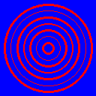
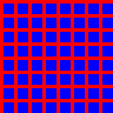
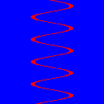



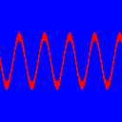
Training - Dataset
I used Claude AI to create Different Shapes and patterns of Red and Blue colors to train my model on
This was better than an online dataset, As I just needed to train on patterns, not necessarily the colors, and red and blue is perfect opposites to use (I'm already using black and white for the masks)
Allows for unlimited possibilities

Slide 6
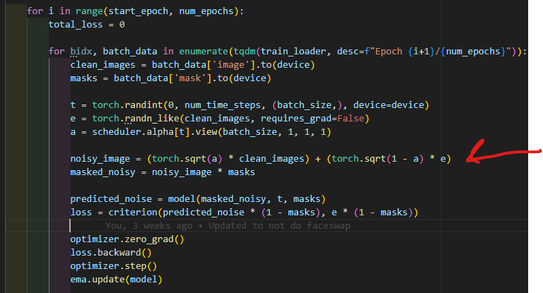
Diffusion Process
To teach the AI how to fix noisy images, we first must teach it what noise looks like.
Think of it like showing the AI a picture and slowly turning the “static” knob on a TV until the picture disappears.
Start with a clean image
Add a tiny bit of noise
Add more noise, repeatedly (0 – 999 steps)
The schedule is just how much noise we add at each step
During training, we pick a random step each time, sometimes lightly noisy, sometimes heavily noisy, sometimes almost all static.
The AI sees images at every possible noise level.
This teaches it: “If the image looks this noisy, here is how to clean it.”

Slide 7

Training Loop
Give AI a picture
Cover up a random section
Add noise (make it fuzzy)
Ask the AI: “What did the missing piece look like before?”
It tries. It gets it wrong. We correct it. It tries again, thousands of times.

Slide 8
What is Regularization
Techniques to prevent overfitting and improve model generalization. Without regularization, the model might memorize training data instead of learning patterns.
Dropout: “Sometimes I cover one of the AI’s eyes so it learns better.”
EMA: “I keep a slow, stable version of the AI as a safety copy.”
Group Normalization: “Keeps the AI’s thoughts organized.”
Notes:
EMA - Exponential Moving Average

Slide 9
Group Normalization Example
Notes:
Group Normilization
If Kallakunta had to answer 200 questions from 200 students, it could be a lot to handle
But, if it was smaller groups, it would be more organized and easier to manage

Slide 10

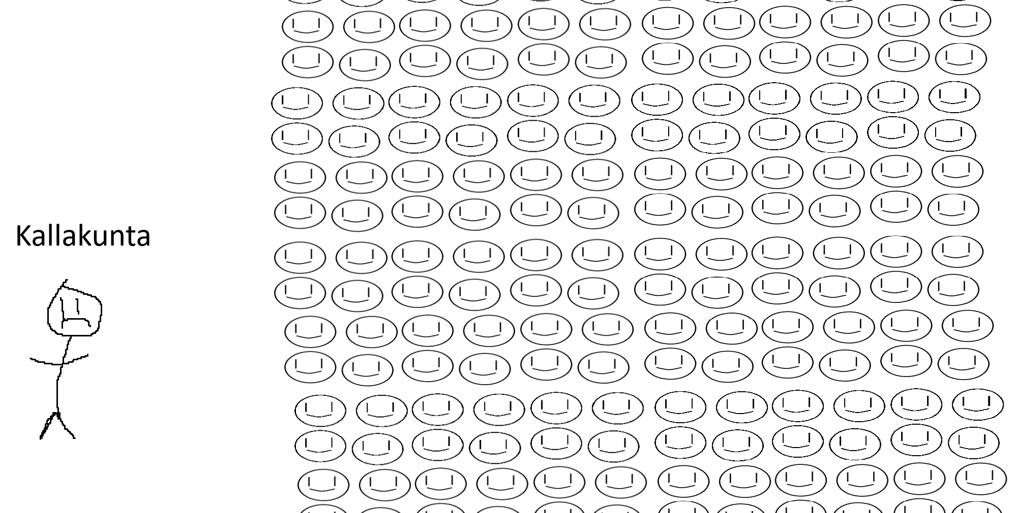




Denver Kosch

Slide 11
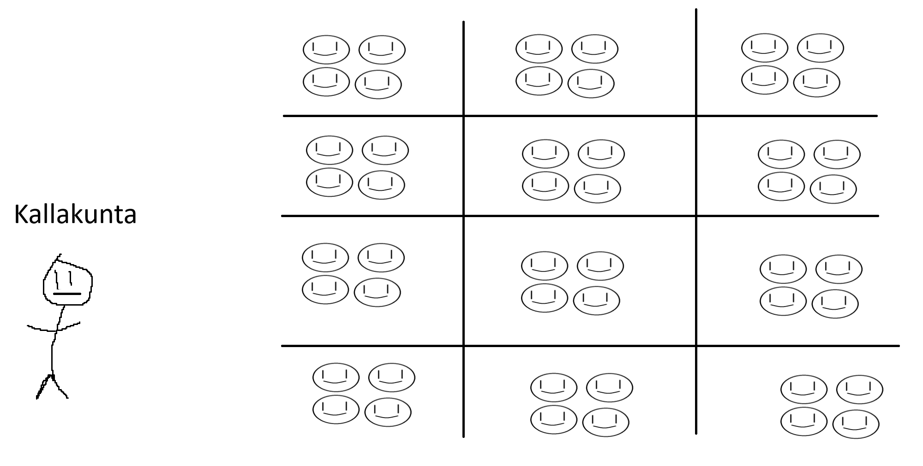






Slide 12




Slide 13
Loss Function Design
My loss is only supposed to look at the masked areas of an image, not the entire image as a whole
“When the AI fills in the blank, I only grade the part it actually had to guess.”
If you give a student a worksheet and they only need to fill in the missing blanks, you don’t grade them on the part already filled out.

Slide 14
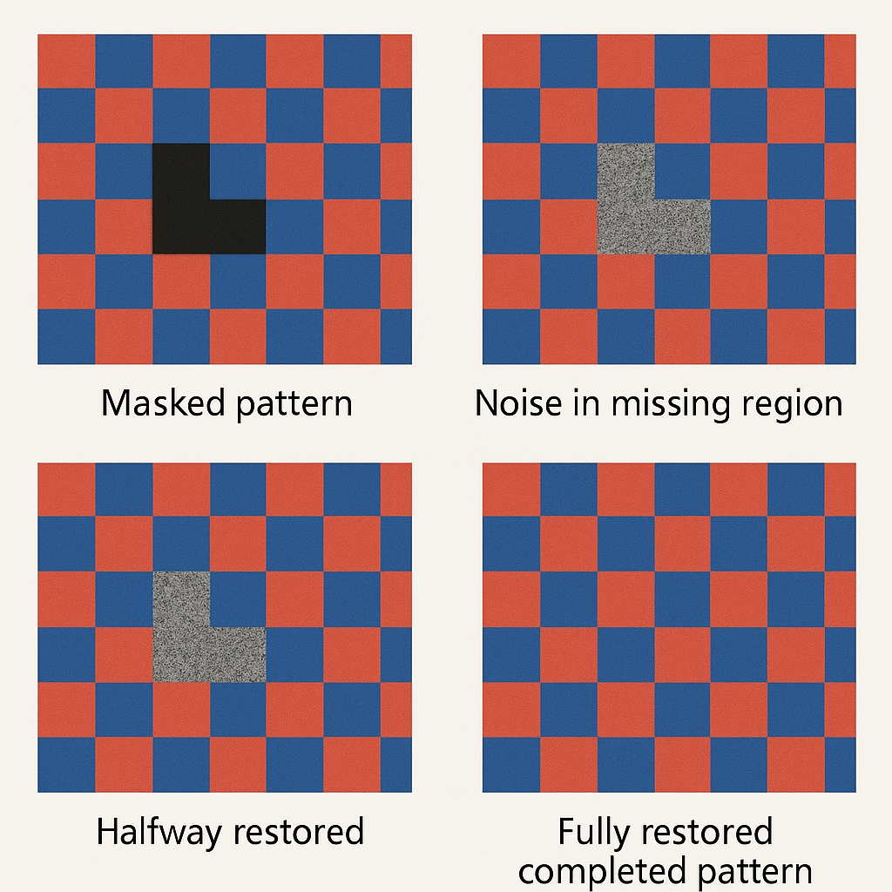
Inference – Pattern Completion
Reverse Denoising Process
The known parts of the pattern stay the same
The missing part starts as pure noise
The AI cleans the noise little by little
After many steps, the missing part becomes a believable continuation of the pattern

Slide 15
Results and Summary
What the Model Learns:
Checkerboard continuation rules
Stripe direction and spacing
Grid intersection patterns
Wave frequency and amplitude
Geometric consistency
RED/BLUE color pattern rules
Why It Works:
Stable training (no adversarial dynamics)
Learns pattern structure rules
Iterative refinement during inference
Mask conditioning allows precise control
Training Stats:
200 Epochs | 2000 sets. Batches of 16

Slide 16
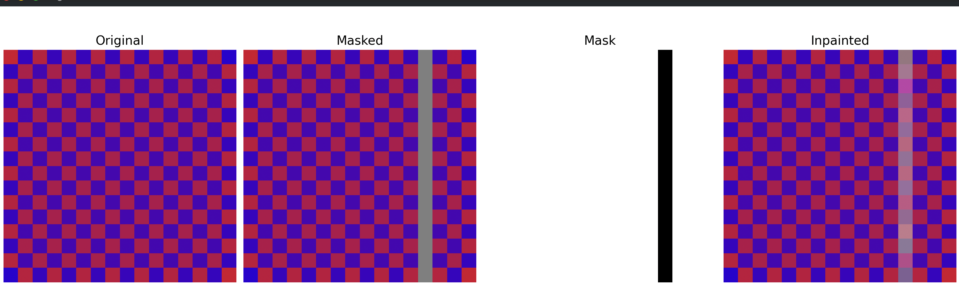

Slide 18
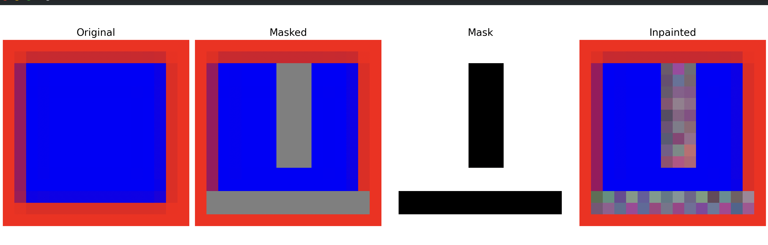

Slide 20
